Slide 1

COMPUTER NETWORK
CHINESE NAME:葉梅
ID NUMBER:411OE241

Slide 2
AGENDA
COMPUTER NETWORKING
CRITERIA OF GOOD NETWORK
GOAL OF NETWORKING
TYPES OF NETWORKING
DIVISION BASED ON AREA COVERED
BASED ON TYPES OF COMMUNICATION
BASED ON THE TYPES OF ARCHITECTURE
NETWORK TROPOLOGY AND DISADVANTAGES AND ADVANTAGES
NETWORKING DEVICES
INTERNET
SOLUTION

Slide 3
01.
WHAT IS COMPUTER NETWORK

Slide 4
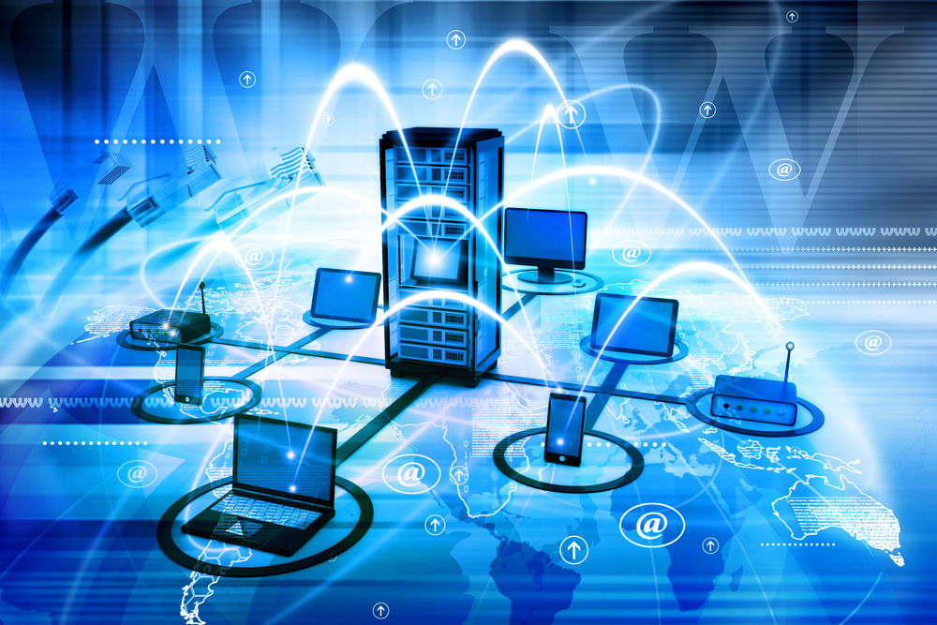
COMPUTERNEWORK
computer network is a system that connects numerous independent computers in order to share information (data) and resources. The integration of computers and other different devices allows users to communicate more easily.

Slide 5
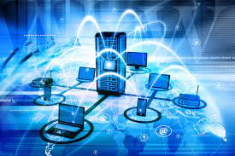
computer network is a collection of two or more computer systems that are linked together. A network connection can be established using either cable or wireless media. Hardware and software are used to connect computers and tools in any network

Slide 6
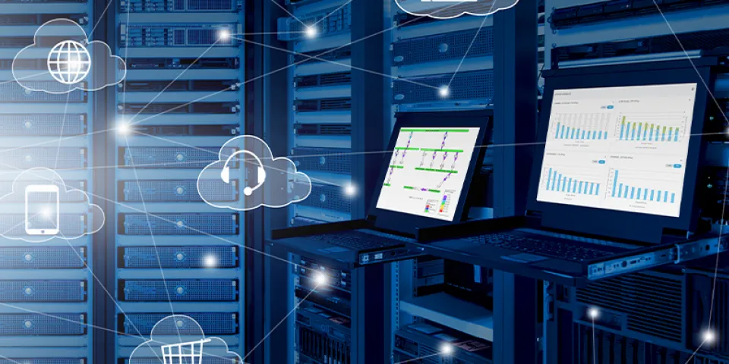
computer network consists of various kinds of nodes. Servers, networking hardware, personal computers, and other specialized or general-purpose hosts can all be nodes in a computer network. Hostnames and network addresses are used to identify them.

Slide 7
02.
THIS OUR THE CRITERIA OF GOOD NETWORK

Slide 8
CRITERIA OF GOOD NETWORK
PERFORMANCE
RELIABILITY
SECURITY

Slide 9
PERFORMANCE
It can be measured in many ways, including transmit time and response time. Transit time is the amount of time required for a message to travel from one device to another. Response time is the elapsed time between an inquiry and a response. The performance of the network depends on a number of factors, including the number of users, the type of medium & hardware

Slide 10
RELIABILITY
In the addition to accuracy is measured by frequency of failure, the time it takes a link to recover from failure, and the network’s robustness in catastrophe.

Slide 11
SECURITY
Network security issues include protecting data from unauthorized access, protecting data from damage and development, and implementing policies and procedures for recovery from breaches and data loss.

Slide 12
03. THIS OUR THE GOAL OF NETWORK
CHECK IN THE NEXT SLIDE

Slide 13
GOAL OF NETWORKING

Slide 14
Programs do not have to execute on a single system because of resource and load sharing.
Reduced costs – Multiple machines can share printers, tape drives, and other peripherals.
Reliability – If one machine fails, another can take its place.
Scalability (it’s simple to add more processors or computers)
Communication and mail (people living apart can work together)
Information Access (remote information access, access to the internet, e-mail, video conferencing, and online shopping)
Entertainment that is interactive (online games, videos, etc.)
Social Networking

Slide 15
TYPES OF NETWORKING
Wired Network
Wireless Network

Slide 16
04. WHAT IS WIRED NETWORK

Slide 17
Wired Network
As we all know, “wired” refers to any physical medium made up of cables. Copper wire, twisted pair, or fiber optic cables are all options. A wired network employs wires to link devices to the Internet or another network, such as laptops or desktop PCs.

Slide 18
05. WHAT WIRELESS NETWORK

Slide 19
Wireless Network
“Wireless” means without wire, media that is made up of electromagnetic waves (EM Waves) or infrared waves. Antennas or sensors will be present on all wireless devices. Cellular phones, wireless sensors, TV remotes, satellite disc receivers, and laptops with WLAN cards are all examples of wireless devices. For data or voice communication, a wireless network uses radio frequency waves rather than wires.

Slide 20
06. THESE ARE THE DIVISION BASED ON AREA COVERED

Slide 21
DIVISION BASED ON AREA COVERED
Local Area Network (LAN)
Metropolitan Area Network (MAN)
Wide Area Network (WAN)
Point To Point
Switched

Slide 22
07.
WHAT IS LOCAL AREA NETWORK?

Slide 23
Local Area Network (LAN)
A LAN is a network that covers an area of around 10 kilometers. For example, a college network or an office network. Depending upon the needs of the organization, a LAN can be a single office, building, or Campus. We can have two PCs and one printer in-home office or it can extend throughout a company and include audio and video devices. Each host in LAN has an identifier, an address that defines hosts in LAN. A packet sent by the host to another host carries both the source host’s and the destination host’s address.

Slide 24
08.
WHAT IS Metropolitan Area Network (MAN)

Slide 25
Metropolitan Area Network (MAN)
MAN refers to a network that covers an entire city. For example: consider the cable television network.

Slide 26
09.
WHAT IS Wide Area Network (WAN)

Slide 27
Wide Area Network (WAN)
WAN refers to a network that connects countries or continents. For example, the Internet allows users to access a distributed system called www from anywhere around the globe.WAN interconnects connecting devices such as switches, routers, or modems. A LAN is normally privately owned by an organization that uses it. We see two distinct examples of WANs today: point-to-point WANs and Switched WANs

Slide 28
Point To Point
Switched
Connects two connecting devices through transmission media.
A switched WAN is a network with more than two ends.

Slide 29
BASED ON TYPES OF COMMUNICATION
POINT TO POINT NETWORKS
MULTIPOINT
BROADCAST NETWORKS

Slide 30
POINT TO POINT NETWORKS
Point-to-Point networking is a type of data networking that establishes a direct link between two networking nodes. A direct link between two devices, such as a computer and a printer, is known as a point-to-point connection.

Slide 31
MULTIPOINT
is the one in which more than two specific devices share links. In the multipoint environment, the capacity of the channel is shared, either spatially or temporally. If several devices can use the link simultaneously, it is a spatially shared connection.

Slide 32
BROADCAST NETWORKS
In broadcast networks, a signal method in which numerous parties can hear a single sender. Radio stations are an excellent illustration of the “Broadcast Network” in everyday life. The radio station is a sender of data/signal in this scenario, and data is only intended to travel in one direction. Away from the radio transmission tower, to be precise.

Slide 33
BASED ON THE TYPES OF ARCHITECTURE
P2P NETWORKS
CLIENT-SERVER NETWORKS
HYBRID NETWORKS

Slide 34
P2P NETWORKS
Computers with similar capabilities and configurations are referred to as peers. “Peer to Peer” is the abbreviation for “peer to peer.” The “peers” in a peer-to-peer network are computer systems that are connected to each other over the Internet. Without the use of a central server, files can be shared directly between systems on the network.

Slide 35
CLIENT-SERVER NETWORKS
Each computer or process on the network is either a client or a server in a client-server architecture (client/server). The client asks for services from the server, which the server provides. Servers are high-performance computers or processes that manage disc drives (file servers), printers (print servers), or network traffic (network servers)

Slide 36
HYBRID NETWORKS
he hybrid model refers to a network that uses a combination of client-server and peer-to-peer architecture. Eg: Torrent.

Slide 37
NETWORK TROPOLOGY DISADVANTAGES AND ADVANTAGES
BUS TROPOLOGY
RING TROPOLOGY
STAR TROPOLOGY
MESH TROPOLOGY
TREE TROPOLOGY

Slide 38
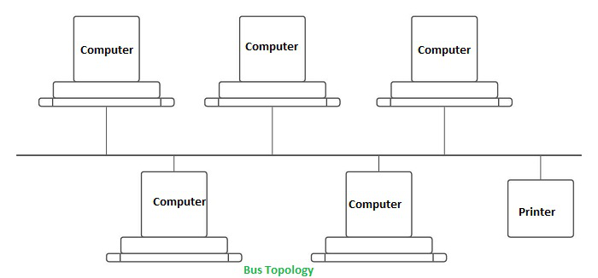
BUS TROPOLOGY
Every computer and network device is connected to a single cable in a bus topology network. Linear Bus topology is defined as having exactly two terminals.

Slide 39
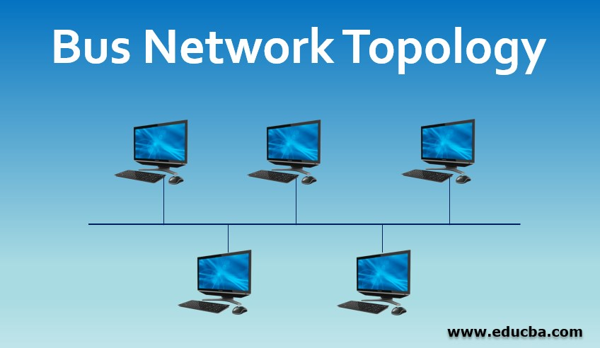
Advantages
Installation is simple.
Compared to mesh, star, and tree topologies, the bus utilizes less cabling.
Disadvantages
Difficulty in reconfiguring and isolating faults.
A bus cable malfunction or break interrupts all communication.

Slide 40

Disadvantages
Difficulty in reconfiguring and isolating faults.
A bus cable malfunction or break interrupts all communication.

Slide 41
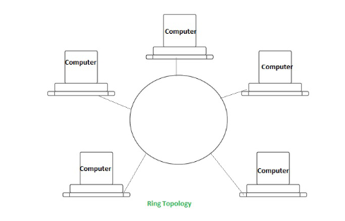
RING TROPOLOGY
The topology is named ring topology because one computer is connected to another, with the final one being connected to the first. Exactly two neighbors for each device. A signal is passed along the ring in one direction. Each ring incorporates a repeater.

Slide 42
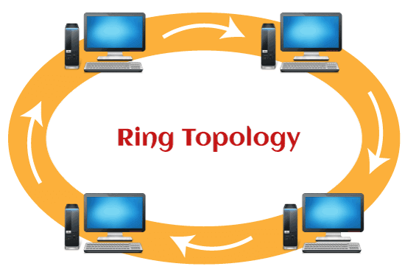
Advantages
Data transmission is relatively straightforward because packets only move in one direction.
There is no requirement for a central controller to manage communication between nodes.
Easy installation & Reconfiguration
Simplified Faulty connections

Slide 43
Disadvantages
In a Unidirectional Ring, a data packet must traverse through all nodes.
All computers must be turned on in order for them to connect with one another.

Slide 44
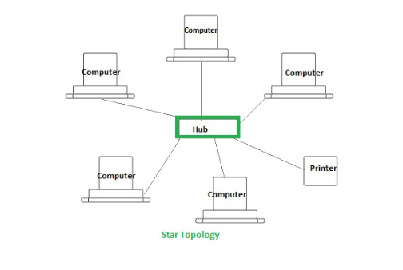
STAR TROPOLOGY
Star Topology: Each device in a star topology has a dedicated point-to-point link to a central controller, which is commonly referred to as the HUB. There is no direct connection between the devices. Traffic between the devices is not allowed in this topology. As an exchange, the controller is used.

Slide 45
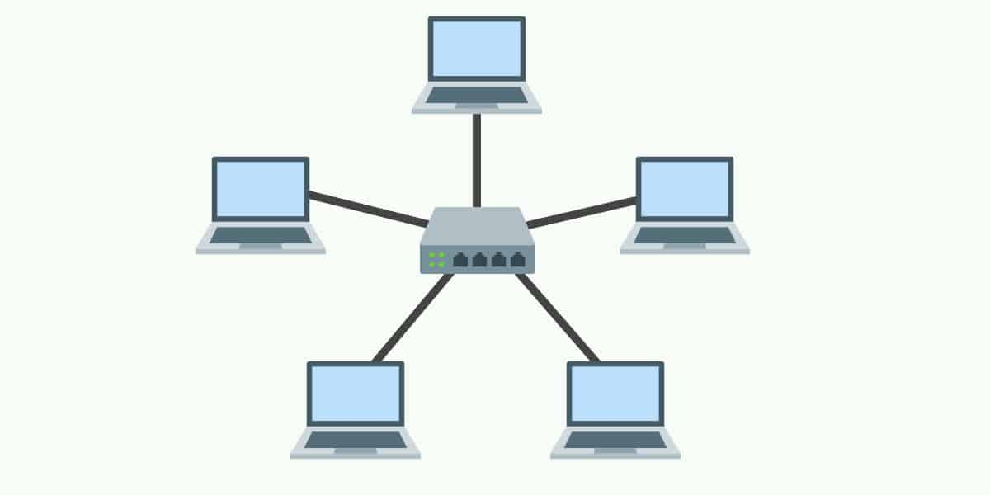
Advantages
When attaching or disconnecting devices, there are no network interruptions.
It’s simple to set up and configure.
Identifying and isolating faults is simple.
Less Expensive than mesh
Easy to install & configure

Slide 46
Disadvantages
Nodes attached to the hub, switch, or concentrator is failed if they fail.
Because of the expense of the hubs, it is more expensive than linear bus topologies.
More cable required compared to bus or ring
Too much dependency on Hub

Slide 47
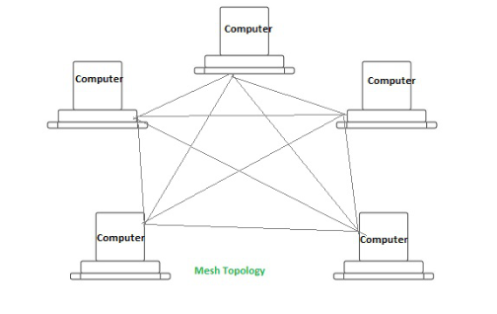
MESH TROPOLOGY
Every device in a mesh topology has dedicated point-to-point connectivity to every other device. The term “dedicated” refers to the fact that the link exclusively transports data between the two devices it links. To connect n devices, a fully connected mesh network contains n *(n-1)/2 physical channels.

Slide 48
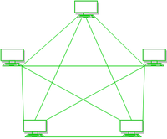
Advantages
Data can be sent from multiple devices at the same time. This topology can handle a lot of traffic.
Even if one of the connections fails, a backup is always available. As a result, data transit is unaffected.

Slide 49
Physical boundaries prevent other users from gaining access to messages
Point to Point links make fault transmission & fault isolation easy

Slide 50
Disadvantages
The amount of cabling and the number of I/O ports that are necessary.
The sheer bulk of wiring can be greater than the available space can accommodate.
It is difficult to install and reconfigure.

Slide 51
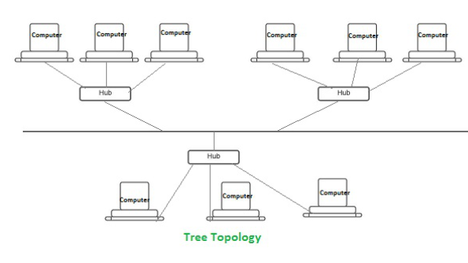
TREE TROPOLOGY
Tree Topology: The topology of a tree is similar to that of a star. Nodes in a tree, like those in a star, are connected to a central hub that manages network traffic. It has a root node, which is connected to all other nodes, producing a hierarchy. Hierarchical topology is another name for it. The number of Star networks is connected via Bus in Tree Topology.

Slide 52
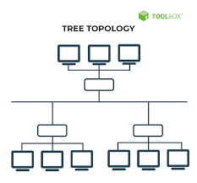
Advantages
Network expansion is both possible and simple.
We partition the entire network into pieces (star networks) that are easier to manage and maintain.
Other segments are unaffected if one segment is damaged.

Slide 53
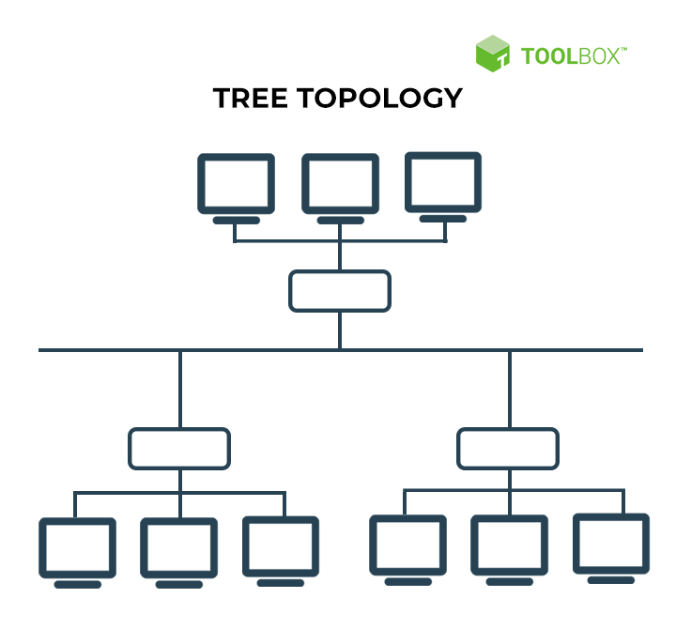
Disadvantages
Tree topology relies largely on the main bus cable because of its basic structure, and if it fails, the entire network is handicapped.
Maintenance becomes more challenging when more nodes and segments are added.

Slide 54
NETWORKING DEVICES
Basic hardware interconnecting network nodes, such as Network Interface Cards (NICs), Bridges, Hubs, Switches, and Routers, are used in all networks. In addition, a mechanism for connecting these building parts is necessary, which is usually galvanic cable and optical cable are less popular (“optical fiber”)The following are the network devices :

Slide 55
NETWORKING DEVICES
NIC (NETWORK INTERFACE CARD)
REPEATER
HUB
BRIDGES
SWITCHES
ROUTERS
GATWAY

Slide 56
NIC (NETWORK INTERFACE CARD)
A network card, often known as a network adapter or NIC (network interface card), is computer hardware that enables computers to communicate via a network. It offers physical access to networking media and, in many cases, MAC addresses serve as a low-level addressing scheme. Each network interface card has a distinct identifier. This is stored on a chip that is attached to the card.

Slide 57
REPEATER
A repeater is an electrical device that receives a signal, cleans it of unwanted noise, regenerates it, and retransmits it at a higher power level or to the opposite side of an obstruction, allowing the signal to travel greater distances without degradation. In the majority of twisted pair Ethernet networks, Repeaters are necessary for cable lengths longer than 100 meters in some systems. Repeaters are based on physics.

Slide 58
HUB
A hub is a device that joins together many twisted pairs or fiber optic Ethernet devices to give the illusion as a formation of a single network segment. The device can be visualized as a multiport repeater. A network hub is a relatively simple broadcast device. Any packet entering any port is regenerated and broadcast out on all other ports, and hubs do not control any of the traffic that passes through them. Packet collisions occur as a result of every packet being sent out through all other ports, substantially impeding the smooth flow of communication.

Slide 59
BRIDGES
Bridges broadcast data to all the ports but not on the one that received the transmission. Bridges, on the other hand, learn which MAC addresses are reachable through specific ports rather than copying messages to all ports as hubs do. Once a port and an address are associated, the bridge will only transport traffic for that address to that port.

Slide 60
SWITCHES
A switch differs from a hub in that it only forwards frames to the ports that are participating in the communication, rather than all of the ports that are connected. The collision domain is broken by a switch, yet the switch depicts itself as a broadcast domain. Frame forwarding decisions are made by switches based on MAC addresses.

Slide 61
ROUTERS
Routers are networking devices that use headers and forwarding tables to find the optimal way to forward data packets between networks. A router is a computer networking device that links two or more computer networks and selectively exchanges data packets between them. A router can use address information in each data packet to determine if the source and destination are on the same network or if the data packet has to be transported between networks. When numerous routers are deployed in a wide collection of interconnected networks, the routers share target system addresses so that each router can develop a table displaying the preferred pathways between any two systems on the associated networks.

Slide 62
GATEWAYS
To provide system compatibility, a gateway may contain devices such as protocol translators, impedance matching devices, rate converters, fault isolators, or signal translators. It also necessitates the development of administrative procedures that are acceptable to both networks. By completing the necessary protocol conversions, a protocol translation/mapping gateway joins networks that use distinct network protocol technologies.

Slide 63
INTERNET
The internet is a larger network that allows computer networks controlled by enterprises, governments, colleges, and other organizations all over the world to communicate with one another. As a result, there are a tangle of cables, computers, data centers, routers, servers, repeaters, satellites, and wi-fi towers that allow digital data to go around the world.

Slide 64
The Internet is a vast network of networks that functions as a networking infrastructure. It links millions of computers throughout the world, creating a network in which any computer can talk with any other computer as long as they are both linked to the Internet.
The Internet is a global network of interconnected computers that communicate and share information using a standardized Internet Protocol Suite.

Slide 65
Sample Questions
Question 1: List the advantages and disadvantages of the internet.
Solution:
Advantages of internet are,
Source of entertainment – Online gaming, talking, browsing, music, movies, dramas, and TV series are quickly becoming the most popular ways to pass the time.
Source of information – There is no better place to conduct research than the internet. We can learn about the latest trends, communicate with experts without having to physically visit them, and seek professional advice over the internet.

Slide 66
E – Commerce – With the advancement of internet technology, large online E-commerce enterprises such as Amazon, Ali Baba, myntra etc. have emerged.
Working from home, collaborating with others, and having access to a global workforce are all advantages.
Keeps Updated – Because there are hundreds of thousands of newsgroups and services that keep you updated with every tick of the clock, the Internet is a source of the most recent news.

Slide 67
Disadvantages of internet are,
Time Wastage – Most people believe that spending too much time on the internet is unhealthy for young people and leads to obesity.
Money Laundering – Aside from reputable sites, there are some Social Media Advertising sites that try to steal your personal information, credit card information, and even your pin code. You can easily become a victim of money scam if they get this information.

Slide 68
Exposure to private data – It is now quite easy to decipher someone’s chat or email communication thanks to the hacking community. As we all know, data is transmitted in packets, which hackers can simply detect and reconstruct.
Harassment & threatening – Bullies exist online, just as they do in real life, and they can lower your self-esteem by harassing and threatening you. Some of these individuals may be persons who are aware of some of your personal details and dislike you, and may use this information to harass you.

Slide 69
Question 2: List the ways to connect to the internet.
Solution:
We can connect to the internet in the following ways:
Dial-Up – In order to access the Internet, in this type of connection, users must connect their phone line to a computer . This link prevents the user from using tier home phone service to make or receive calls.

Slide 70
Broadband – Broadband is a high-speed internet connection that is frequently utilized nowadays and is provided by cable or phone companies.
Wireless connections – Internet access is accomplished by radio waves, thus it is possible to connect to the Internet from any location. Wi-Fi and mobile service providers are examples of wireless connections.

Slide 71
Broadband – Broadband is a high-speed internet connection that is frequently utilized nowadays and is provided by cable or phone companies.
Wireless connections – Internet access is accomplished by radio waves, thus it is possible to connect to the Internet from any location. Wi-Fi and mobile service providers are examples of wireless connections.

Slide 72
Question 4: What is the full form of www?
Solution:
The full form of www is World Wide Web. It is the world’s most dominant software and is commonly known as the web.

Slide 73
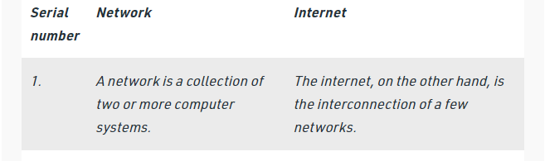
Question 5: What is the basic difference between the Internet and the network?
Solution:

Slide 74
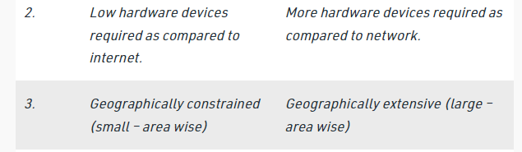

Slide 75
